Slide 1




Financial Org Rating System
Presented by:
Chaitra r
Vinutha
Chaitanya

Slide 2
Contents
INTRODUCTION
PROJECT SCOPE
MODULES
USE CASE DIAGRAM
CLASS DIAGRAM
TECHNOLOGY USED
FUTURE SCOPE
CONCLUSION

Slide 3
INTRODUCTION
Financial org rating system provides the service of viewing all the feedbacks and organization details to the users.

Slide 4
PROJECT SCOPE
The project has a wide scope . This project is going to develop generic software, which can be applied by any business organization. More over It provides facility to its users. Also the software is going to provide a huge amount of summary data.

Slide 5
MODULES
USER
FINANCE ADMIN
OGANIZATION

Slide 6
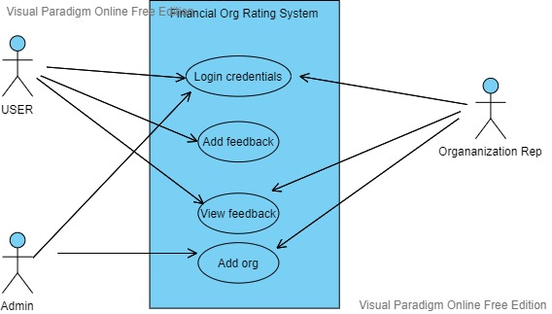
USE CASE DIAGRAM

Slide 7
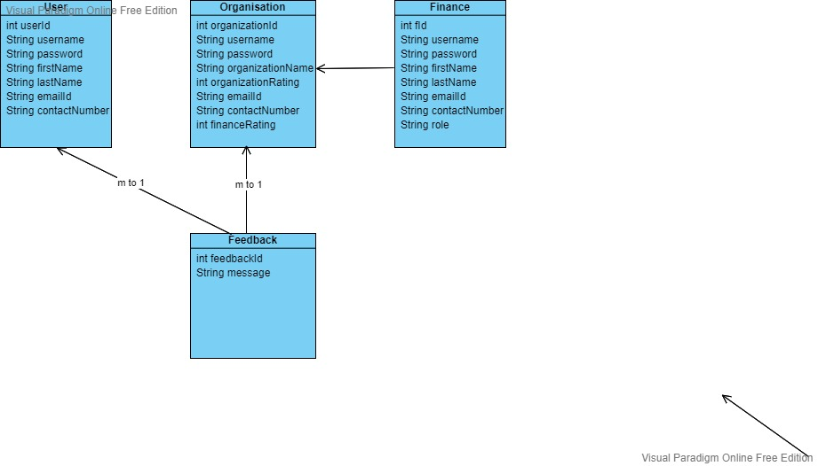
CLASS DIAGRAM

Slide 8
TECHNOLOGY USED
JAVA 8
STS IDE
ORACLE

Slide 9
FUTURE SCOPE
This application helps the users by providing details of the organization so that they can view all the feedbacks for all organization.

Slide 10
CONCLUSION
The project entitled “FINANCIAL ORG RATNG SYSTEM” is developed using Java to track the details of organization.

Slide 11

THANK YOU

